Slide 1
IRAD Program Review – ASSETS: Cloud Computing
^{May 2016}

Slide 2
ASSETS: Cloud Computing
Project Overview
Technical Approach
Develop tools and approaches to operate in the cloud environment.
To demonstrate our ability to address key challenges in cloud computing, such as the allocation of resources on demand and machine learning.
The Cloud Computing Data Processing IRAD will take advantage of components, such as EC2, RDS, EMR, and CloudWatch, provided by cloud computing services for resource allocation
The goal is to create an engine and a framework that will facilitate the addition and integration of processing modules for data analysis and dissemination
The framework will provide:
  Graphical User Interface to configure the system and to manage components
  All basic modules to interact with the different components from the cloud provider
  A set of API to quickly develop and integrate custom modules to be used on a system
  Basic machine learning algorithms to process Big Data
  An engine that will tie them together
We propose implementing this IRAD on AWS. We think this approach is reasonable because of some important government implementations of IC-ITE, such as C2S and GovCloud, are built on AWS.
  We will lease cloud computing resources and components from Amazon.
The key features we need to implement are:
  User Interface
    Thin client approach so it can be accessed remotely
    Allows users to create the chain required to generate a system
    Allows user to add, configure, remove individual modules and systems from the engine
  Framework to support data processing
    A set of API that will allow the user to create custom processing modules
    A set of API to interface with the engine when piecing together an processing system
  Engine running the framework
    Interfaces with all the different cloud provider components and reacts accordingly
    Uses a factory design pattern to isolate cloud provider with the rest of the system
  Machine Learning
    Provides an open source solution to develop and incorporate machine learning into the system
    Basic machine learning components will be available as part of the initial toolset

Slide 3
ASSETS: Cloud Computing
Accomplishments
Next Steps
Acquired a set of self-teaching AWS certification videos
Some of the cloud computer engineers got AWS developer certified
Infrastructure
  Set up accounts and roles
    Oscar Ganteaume, Michael Recachinas, John Irby
  Roles allow the user to log into accounts, create and delete VMs, etc.
  This setup is done through the AWS console – thus we did not accumulate charges for setup
  Setup deployment environment including network access restrictions and security controls
Development
  Implemented a Graphical User Interface prototype
  Implemented a backend server for the GUI
  Implemented an agent to execute tasks remotely
  Implemented a prototype engine to coordinate execution
  Implemented a resource allocator prototype
Near Term Objectives
  Move from proof of concept to a more formal design and implementation framework
  Design interfaces to allow interactions with different AWS resources rather than direct calls
  Design interfaces to allow interactions with other types of resources and tasks
  Design and implement a more dynamic module interaction (upload, download, save, etc)
  Design and implement a more dynamic thread interaction (upload, download, save, etc)
Long Term Objectives
  Learn and implement interfaces with other big-data processing frameworks
  Learn and implement interfaces with other data visualization tools
  Provide a more interactive environment to the user
  Implement Machine Learning modules
  Continue with AWS certification path
Deliverables
  Virtual machine image containing engine and implemented APIs for Graphical User Interface
  Virtual machine image containing a task runner agent
  Implementation of the different prototypes

Slide 4
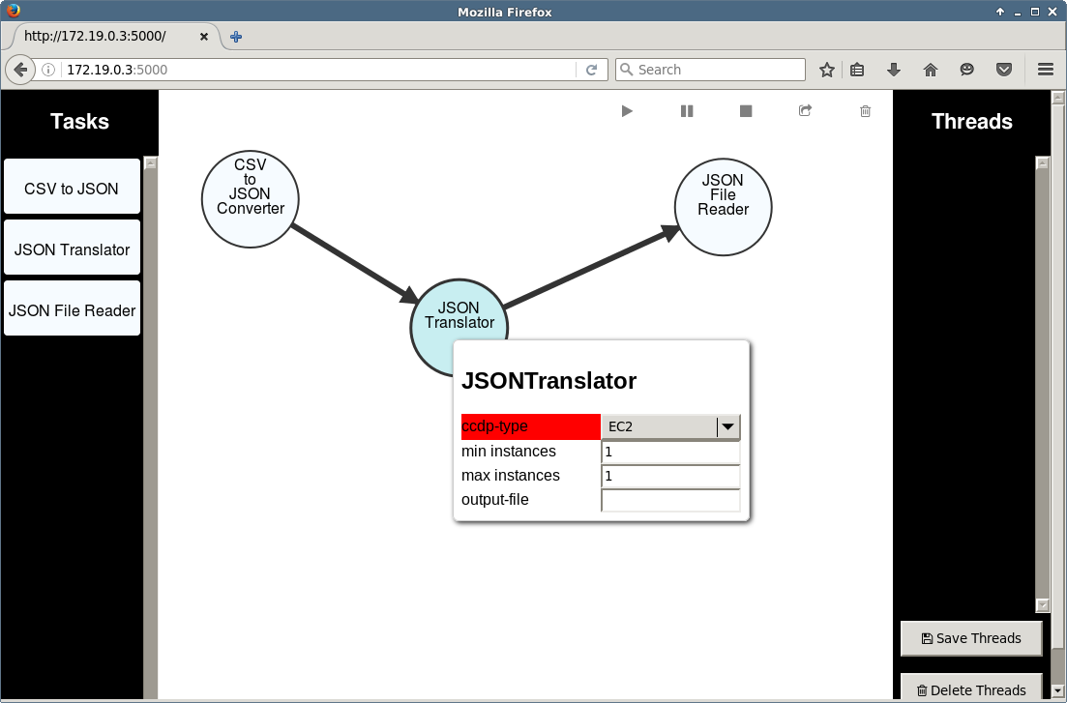
GUI Implementation

